Slide 1
ME 498 Mobile Robot
Logan Beaver and Justin COllins

Slide 2
Problem Statement
The project had the following objectives
Develop a mobile robot that utilizes a differential drive
Implement a control algorithm to move the robot to a waypoint
Integrate the forward and inverse kinematics for a robotic manipulator mounted on the robot
The following objectives were added by the team
Create a high-level controller which orders multiple waypoints into an overall trajectory
Ensure the system works for a variable number of waypoints
Randomly determine the position of the waypoints at runtime

Slide 3
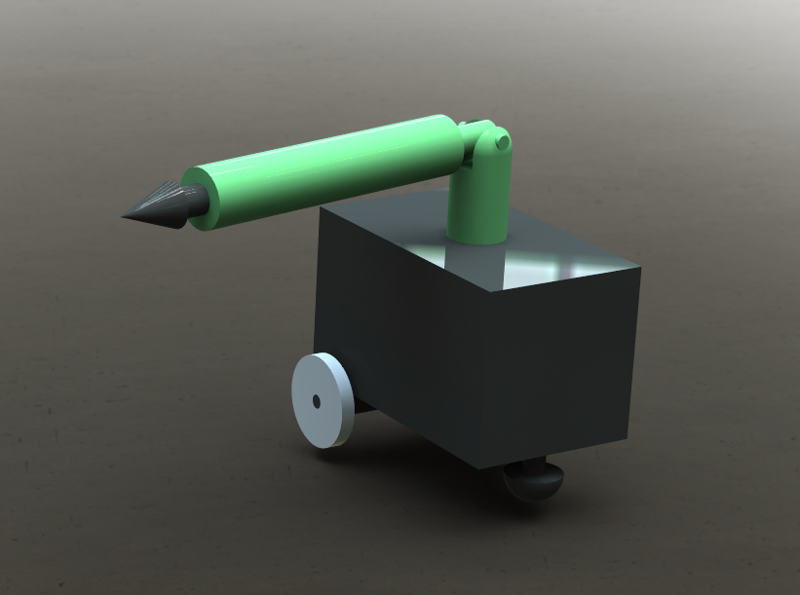
Solution Approach
A differential drive mobile robot was developed with an RRP mechanism mounted on top
Robot utilized feed forward and feedback control to drive to various points
RRP mechanism punctured a target at each waypoint
Developed to arrive at N targets ordered by their proximity to the robot and each other
Moves by spinning then driving

Slide 4
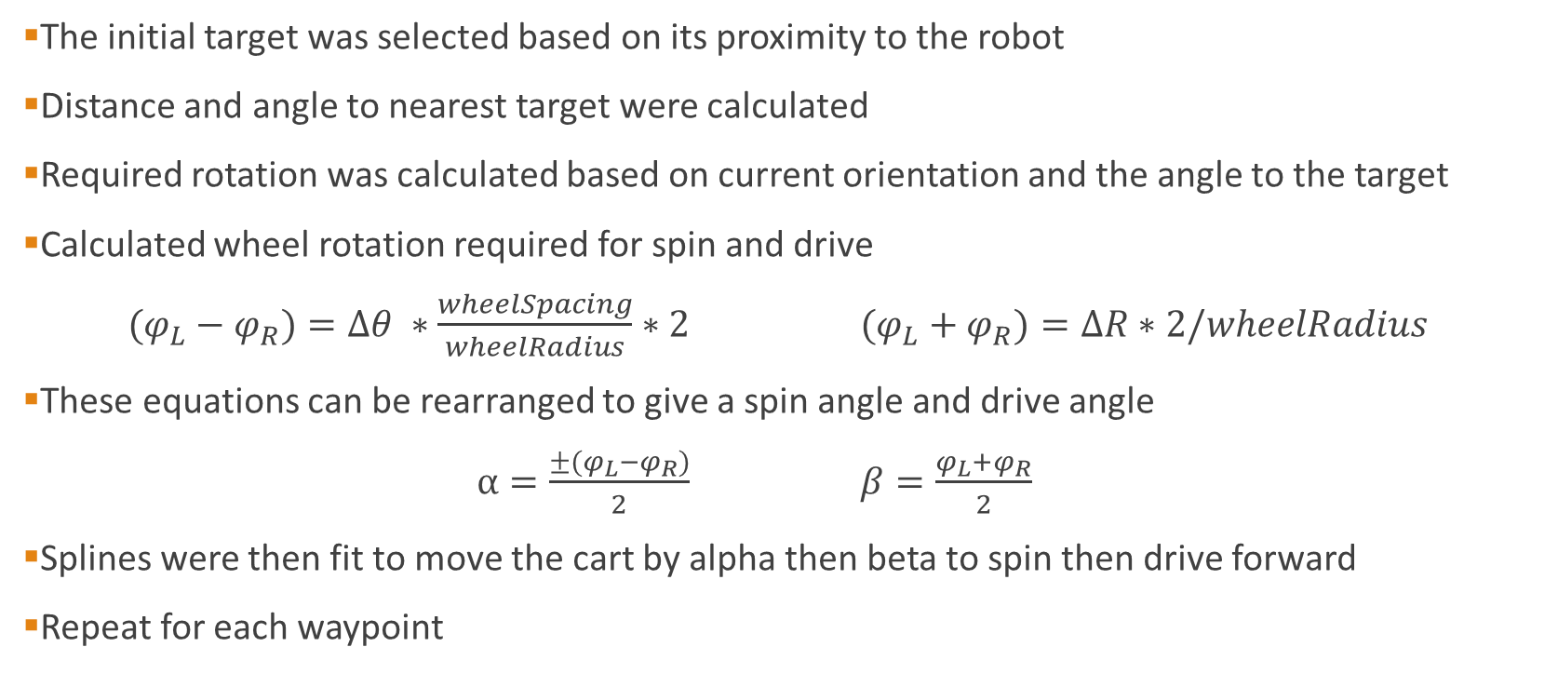
Solution Approach – Path Planning
The initial target was selected based on its proximity to the robot
Distance and angle to nearest target were calculated
Required rotation was calculated based on current orientation and the angle to the target
Calculated wheel rotation required for spin and drive
$(φ_{L}−φ_{R})=∆θ ∗\frac{wheelSpacing}{wheelRadius}∗2$ $(φ_{L}+φ_{R})=∆R∗2/wheelRadius$
These equations can be rearranged to give a spin angle and drive angle
$α=\frac{±(φ_{L}−φ_{R})}{2}$ $β=\frac{φ_{L}+φ_{R}}{2}$
Splines were then fit to move the cart by alpha then beta to spin then drive forward
Repeat for each waypoint

Slide 5
Solution Approach – Differential Control
Simulink model was created and called from a matlab function
Inputs: time array and spline array
Outputs: array of wheel positions
Ran once for left and right wheel
Plant is a basic mechanical motor
Load torque derivation

Slide 6
Solution Approach - Kinematics
Inverse kinematics from textbook
Forward kinematics using DH parameters
Animation done with DH parameters
After first spin-drive cycle inverse kinematics are done on target point
Forward kinematics used to move the arm out and back
Link | A | α | d | θ
Link 1 | 0 | -90 | 6.43” | T1*
Link 2 | 0 | 0 | 2.75” | T2*
Link 3 | 0 | 0 | d3* | 0

Slide 7
Results – Targets and Waypoints
N targets were placed within a 2x2 square
Targets were placed randomly with a uniform distribution
Robot initially position at (0,0)
Nearest target is selected then removed from the pool of available targets
Process is repeated for every target

Slide 8
Results – Point to Point Motion
Without control robot successfully moves between waypoints
Can move between any positive number of waypoints (within memory limit)
Two splines generated per waypoint

Slide 9
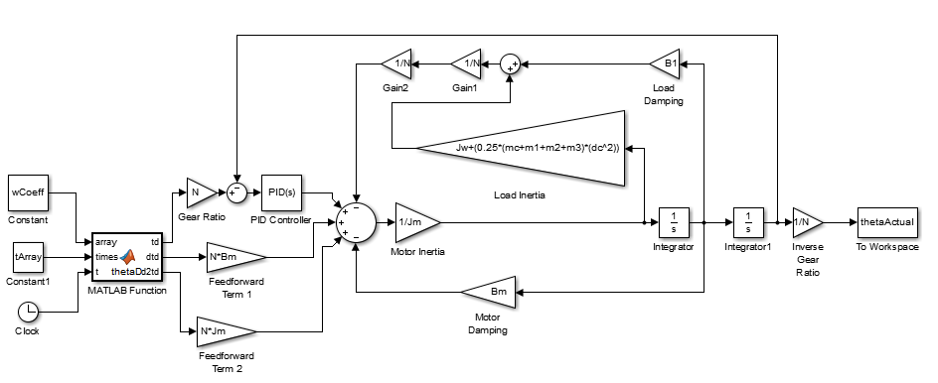
Results – Differential Control

Slide 10
Results – Differential Control
Rigorous PID tuning
Slight overshoot and error quick compounds
Path planning assumes small error in motion

Slide 11
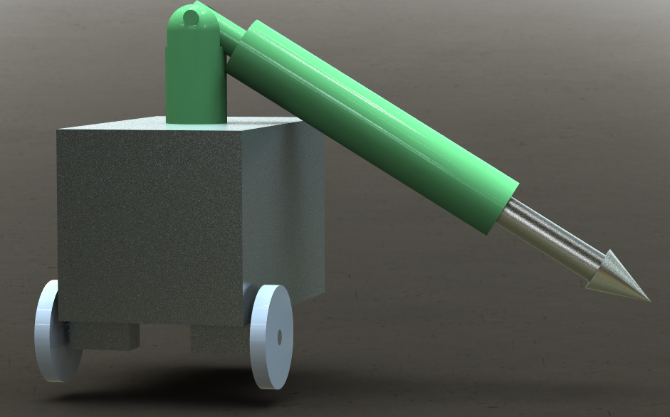
Arm Motion
Between drive and spin phase the arm was actuated
Used inverse kinematics of relative target position to extend
Returns to known initial configuration
RRP design allows for error in mobile robot positioning

Slide 12
Conclusion
Trajectory is path-dependent and required complex algorithms for complex motion
Simulink initial conditions and integrators required one simulation for the full path
Real time path planning reduces error by adjusting the path

